Slide 1
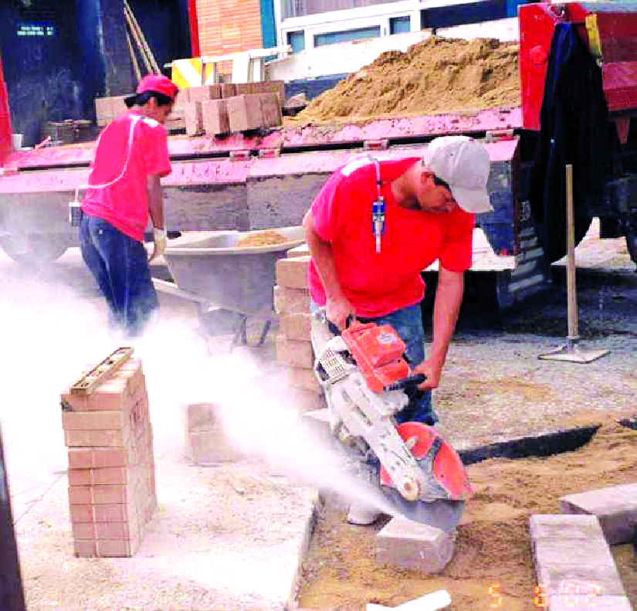
OSHA’s Respirable Crystalline Silica Rule

Slide 2
Exposure and Health Risks
Exposure to respirable crystalline silica has been linked to:
Silicosis;
Lung cancer;
Chronic obstructive pulmonary disease; and
Kidney disease

Slide 3
Scope of Coverage
Three forms of silica:
quartz,
cristobalite
tridymite
Exposures from chipping, cutting, sawing, drilling, grinding, sanding, and crushing concrete, brick, block, rock and stone

Slide 4
Construction
(a) Scope
(b) Definitions
(c) Specified exposure control methods
OR
(d) Alternative exposure control methods
PEL
Exposure Assessment
Methods of Compliance
(e) Respiratory protection
(f) Housekeeping
(g) Written exposure control plan
(h) Medical surveillance
(i) Communication of silica hazards
(j) Recordkeeping
(k) Dates

Slide 5
Permissible Exposure Limit (PEL)
PEL = 50 µg/m³ as an 8-Hour TWA
Action Level = 25 µg/m³ as an 8-Hour TWA

Slide 6
Exposure Assessment
Required if exposures may reasonably be expected to be at or above action level of 25 µg/m³
Exposures assessments must follow:
The performance option
The scheduled monitoring option.

Slide 7
Objective Data
Includes air monitoring data from industry-wide surveys or calculations based on the composition of a substance;
It demonstrates employee exposure associated with a particular product or material or a specific process, task, or activity.
Must reflect workplace conditions closely resembling or with a higher exposure potential than the processes, types of material, control methods, work practices, and environmental conditions in the employer's current operations.

Slide 8
Scheduled Monitoring Option
Prescribed schedule for initial and periodic personal monitoring
If monitoring indicates:
Initial below the AL: no additional monitoring
Above the AL: repeat within 6 months
Above the PEL: repeat within 3 months
When two consecutive non-initial results, taken 7 or more days apart, are below the AL, monitoring can be discontinued
Reassess if circumstances change

Slide 9
Employer shall maintain an accurate record of all exposure measurements and include
The date of measurement for each sample taken;
The task monitored;
Sampling and analytical methods used;
Number, duration, and results of samples taken;
Identity of the laboratory that performed the analysis;
Type of personal protective equipment, such as respirators, worn by the employees monitored; and
Name, social security number, and job classification of all employees represented by the monitoring, indicating which employees were actually monitored.

Slide 10
Methods of Sample Analysis
Employers must ensure that samples are analyzed by an accredited laboratory that follow specified quality control procedures
Appendix A allows use of OSHA, NIOSH, or MSHA method for sampling and analysis

Slide 11
Construction - Specified Exposure Control Methods
Table 1 in the construction standard matches 18 tasks with effective dust control methods and, in some cases, respirator requirements.
Employers that fully and properly implement controls on Table 1 do not have to:
Comply with the PEL
Conduct exposure assessments for employees engaged in those tasks

Slide 12
List of Table 1 Entries
Stationary masonry saws
Handheld power saws
Handheld power saws for fiber cement board
Walk-behind saws
Drivable saws
Rig-mounted core saws or drills
Handheld and stand-mounted drills
Dowel drilling rigs for concrete
Vehicle-mounted drilling rigs for rock and concrete
Jackhammers and handheld powered chipping tools
Handheld grinders for mortar removal (tuckpointing)
Handheld grinders for other than mortar removal
Walk-behind milling machines and floor grinders
Small drivable milling machines
Large drivable milling machines
Crushing machines
Heavy equipment and utility vehicles to abrade or fracture silica materials
Heavy equipment and utility vehicles for grading and excavating

Slide 13
Example of Table 1 Entry
Equipment / Task | Engineering and Work Practice Control Methods | Required Respiratory Protection and Minimum APF
 |  | ≤ 4 hr/shift | > 4 hr/shift
Handheld power saws (any blade diameter) | Use saw equipped with integrated water delivery system that continuously feeds water to the blade. Operate and maintain tool in accordance with manufacturers’ instruction to minimize dust When used outdoors When used indoors or in an enclosed area | None APF 10 | APF 10 APF 10

Slide 14
Example of Table 1 Entry
Equipment / Task | Engineering and Work Practice Control Methods | Required Respiratory Protection and Minimum APF
 |  | ≤ 4 hr/shift | > 4 hr/shift
Stationary masonry saws | Use saw equipped with integrated water delivery system that continuously feeds water to the blade. Operate and maintain tool in accordance with manufacturer’s instructions to minimize dust emissions. | None | None

Slide 15
Methods of Compliance – Hierarchy of Controls
Employers must use engineering or work practice controls to limit exposures to the PEL
Respirators permitted where PEL cannot be achieved with engineering and work practice controls

Slide 16
Construction – Written Exposure Control Plan
The plan must describe:
Tasks involving exposure to respirable crystalline silica
Engineering controls, work practices, and respiratory protection for each task
Housekeeping measures used to limit exposure
Procedures used to restrict access, when necessary to limit exposures

Slide 17
Construction – Competent Person
Competent person is an individual capable of identifying existing and foreseeable respirable crystalline silica hazards, who has authorization to take prompt corrective measures
Makes frequent and regular inspection of job sites, materials, and equipment
Construction employers must designate a competent person to implement the written exposure control plan

Slide 18
Respiratory Protection
Must comply with 29 CFR 1910.134
Respirators required:
While installing or implementing controls or work practices
For tasks where controls or work practices are not feasible
When feasible controls cannot reduce exposures to the PEL

Slide 19
Who is your Respiratory Program Administrator?

Slide 20
Respiratory Protection Program
Written program – selection process
Level of the contaminant?
Medical evaluation
Fit test
Training
Recordkeeping

Slide 21
Housekeeping
When it contributes to exposure, employers must prohibit:
Dry sweeping or brushing
Use of compressed air for cleaning surfaces or clothing
Employer should use ventilation, HEPA vacuums, and wet sweeping.

Slide 22
Construction – Medical Surveillance
Employers must offer medical examinations to workers:
Who will be required to wear a respirator under the standard for 30 or more days a year.
Employers must offer examinations every three years to workers who continue to be exposed above the trigger
Exam includes medical and work history, physical exam, chest X-ray, and pulmonary function test (TB test on initial exam only)

Slide 23
Medical examination continued:
A chest X-ray
(a single posteroanterior radiographic projection or radiograph of the chest at full inspiration recorded on either film (no less than 14 x 17 inches and no more than 16 x 17 inches) or digital radiography systems), interpreted and classified according to the International Labour Office (ILO) International Classification of Radiographs of Pneumoconioses by a NIOSH-certified B Reader;
A pulmonary function test
to include forced vital capacity (FVC) and forced expiratory volume in one second (FEV₁) and FEV₁/FVC ratio, administered by a spirometry technician with a current certificate from a NIOSHapproved spirometry course;
Testing for latent tuberculosis infection; and
Any other tests deemed appropriate by the PLHCP.

Slide 24
Medical Opinion
Worker receives report with medical findings
Employer receives an opinion that describes limitations on respirator use, and if the worker gives written consent, recommendations on:
Limitations on exposure to respirable crystalline silica, and/or
Examination by a specialist

Slide 25
Information provided to the PLHCP
The employer shall ensure that the examining PLHCP has a copy of the standard,
A description of the employee's former, current, and anticipated duties as they relate to the employee's occupational exposure to respirable crystalline silica;
The employee's former, current, and anticipated levels of occupational exposure to respirable crystalline silica;
A description of any personal protective equipment used or to be used by the employee, including when and for how long the employee has used or will use that equipment; and
Information from records of employment-related medical examinations previously provided to the employee and currently within the control of the employer.

Slide 26
PLHCP's report for the employee
A statement indicating the results of the medical examination, including any medical condition(s) that would place the employee at increased risk of material impairment to health from exposure to respirable crystalline silica and any medical conditions that require further evaluation or treatment;
Any recommended limitations on the employee's use of respirators;
Any recommended limitations on the employee's exposure to respirable crystalline silica; and
A statement that the employee should be examined by a specialist (pursuant to paragraph (i)(7) of this section) if the chest X-ray provided in accordance with this section is classified as 1/0 or higher by the B Reader, or if referral to a specialist is otherwise deemed appropriate by the PLHCP.

Slide 27
PLHCP's written medical opinion for the employer
shall be obtained within 30 days of the medical examination and contain:
The date of the examination;
A statement that the examination has met the requirements of this section; and
Any recommended limitations on the employee's use of respirators.

Slide 28
If the employee provides written authorization, the opinion may contain
Any recommended limitations on the employee's exposure to respirable crystalline silica;
A statement that the employee should be examined by a specialist (pursuant to paragraph (i)(7) of this section) if the chest X-ray provided in accordance with this section is classified as 1/0 or higher by the B Reader, or if referral to a specialist is otherwise deemed appropriate by the PLHCP.
the employer shall make available a medical examination by a specialist within 30 days after receiving the PLHCP's written opinion.

Slide 29
Communication of Hazards
Employers required to comply with hazard communication standard (1910.1200)
Address at least the following hazards: Cancer, lung effects, immune system effects, and kidney effects as part of HCS
Train workers on health hazards, tasks resulting in exposure, workplace protections, medical surveillance, and elements of the standard.

Slide 30
Recordkeeping
Must maintain records per 29 CFR 1910.1020 for:
Air monitoring data
Objective data
Medical records

Slide 31
Brian Bothast
Lead Safety and Occupational Health Specialist
Peoria Area OSHA Office
T 309.589.7033
oshapeoria@dol.gov

